Slide 1
Cook Healthy
Srishti Sharma

Slide 2
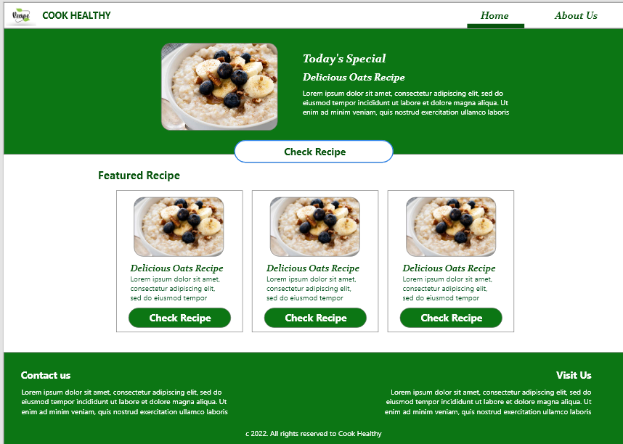
Project overview
The product:
We’re creating an Cook Healthy website to Help people cook their own healthy food. We are providing recipe videos and closed captions (for people with disability).
Keeping the website as simple as possible.
Project duration:
January 2022 to February 2022.

Slide 3
Project overview
The problem:
Busy workers and commuters lack the time necessary to prepare a meal.
The goal:
Design a website for Cook Healthy that allows users to easily order and pick up/get delivery of fresh, healthy dishes.

Slide 4
Project overview
My role:
UX designer designing an app for Invitation Restaurant from conception to delivery.
Responsibilities:
Conducting interviews, paper and digital wireframing, low and high-fidelity prototyping, conducting usability studies, accounting for accessibility, and iterating on designs.

Slide 5
Understanding
the user
User research
Personas
Problem statements
User journey maps

Slide 6
User research: summary
I conducted interviews and created empathy maps to understand the users I’m designing for and their needs. A primary user group identified through research was working adults who don’t have time to cook meals.
This user group confirmed initial assumptions about Srish’s Food Corner customers, but research also revealed that time was not the only factor limiting users from cooking at home. Other user problems included obligations, interests, or challenges that make it difficult to get groceries for cooking or go to restaurants in-person.

Slide 7
User research: pain points
1
2
3
Time
Accessibility
IA
Working adults are too busy to spend time on meal prep
Platforms for ordering food are not equipped with assistive technologies
Text-heavy menus in apps are often difficult to read and order from

Slide 8
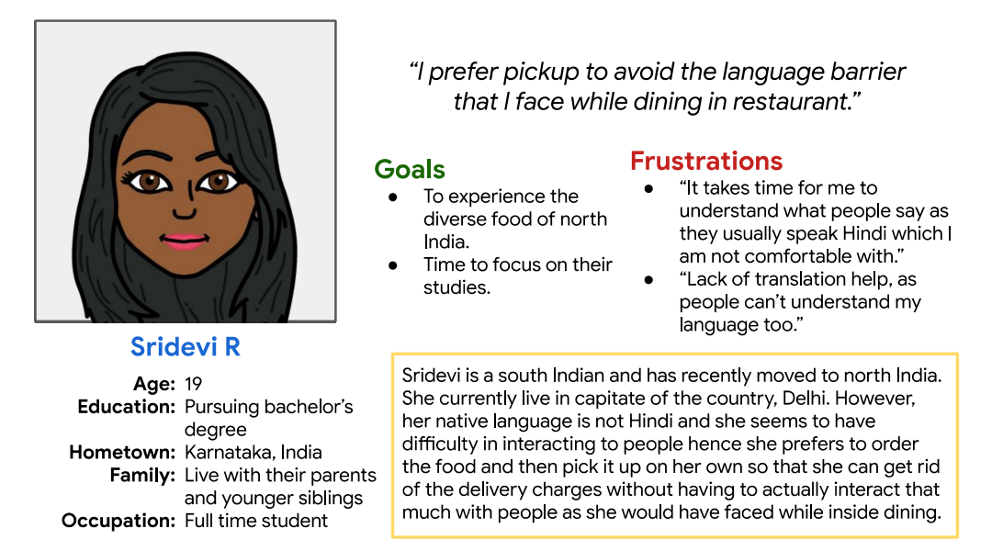
Persona: Sridevi R
Problem statement:
Sridevi is a young female who is having language as a barrier and hence prefer less interaction and more of food pick up availability so that she does not have to pay delivery fee.

Slide 9
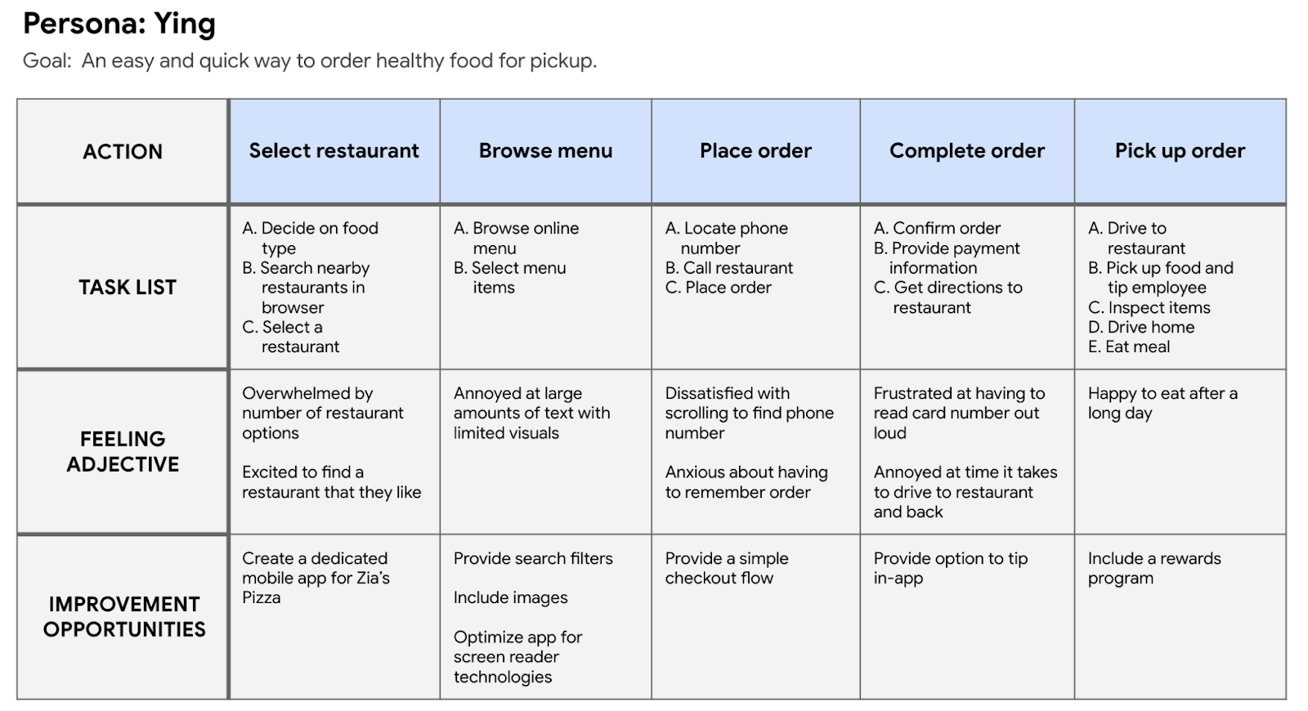
User journey map
Mapping Sridevi’s user journey revealed how helpful it would be for users to have access to a dedicated Invitation Restaurant’s app.

Slide 10
Starting
the design
Paper wireframes
Digital wireframes
Low-fidelity prototype
Usability studies

Slide 11
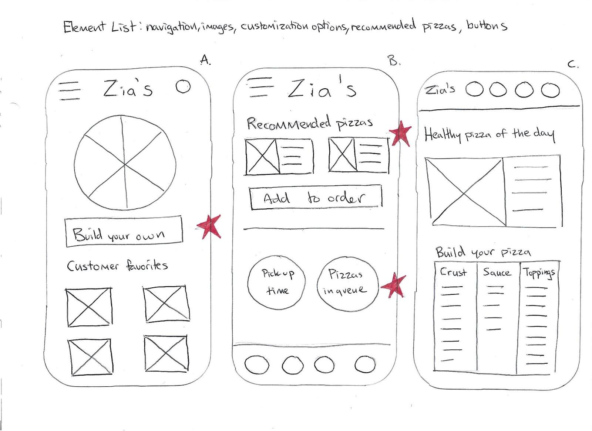
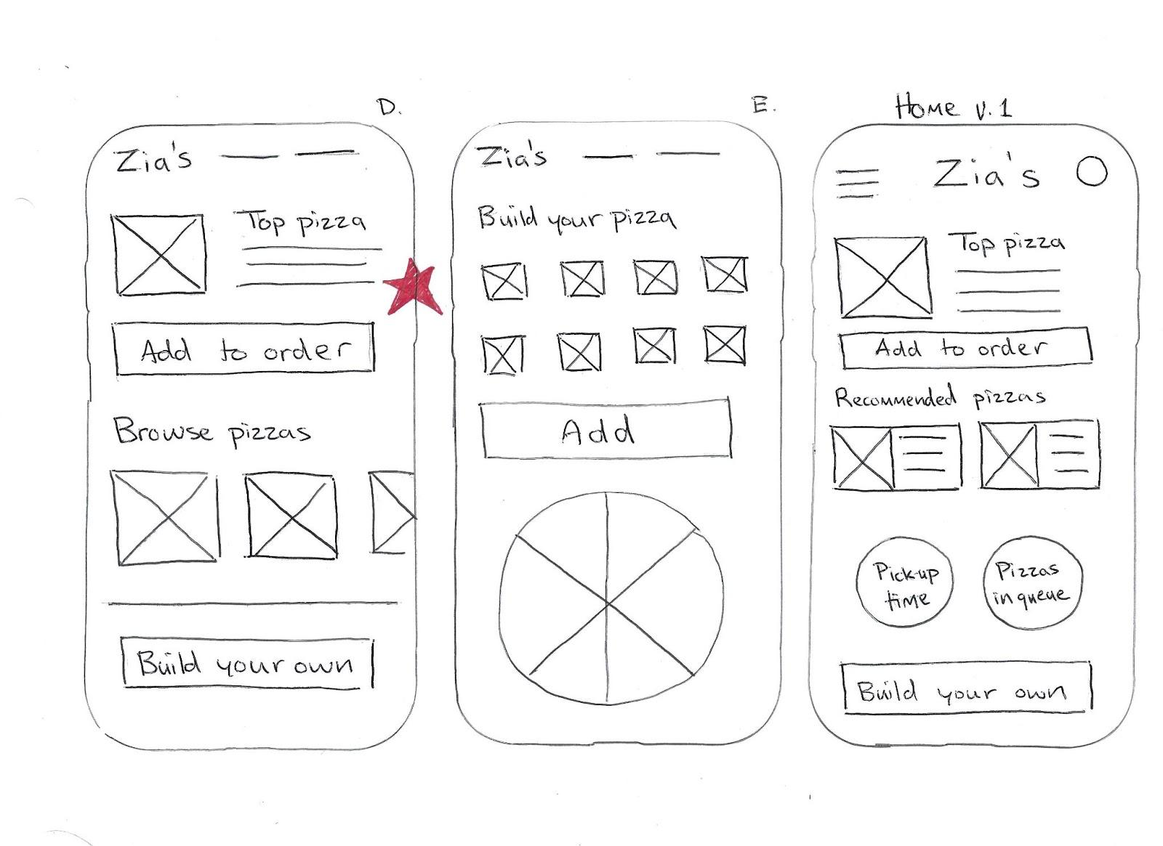
Paper wireframes
Taking the time to draft iterations of each screen of the app on paper ensured that the elements that made it to digital wireframes would be well-suited to address user pain points. For the home screen, I prioritized a quick and easy ordering process to help users save time.
Stars were used to mark the elements of each sketch that would be used in the initial digital wireframes.

Slide 12
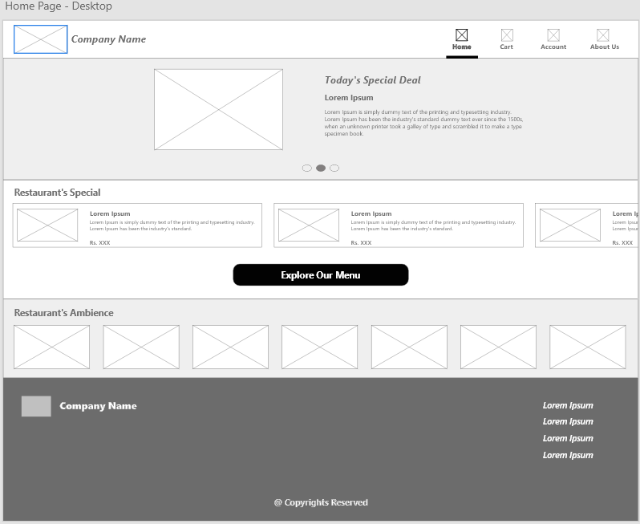
Response Digital
wireframes
As the initial design phase continued, I made sure to base screen designs on feedback and findings from the user research.

Slide 13
Responsive
Digital
wireframes
Easy navigation was a key user need to address in the designs in addition to equipping the app to work with assistive technologies.

Slide 14
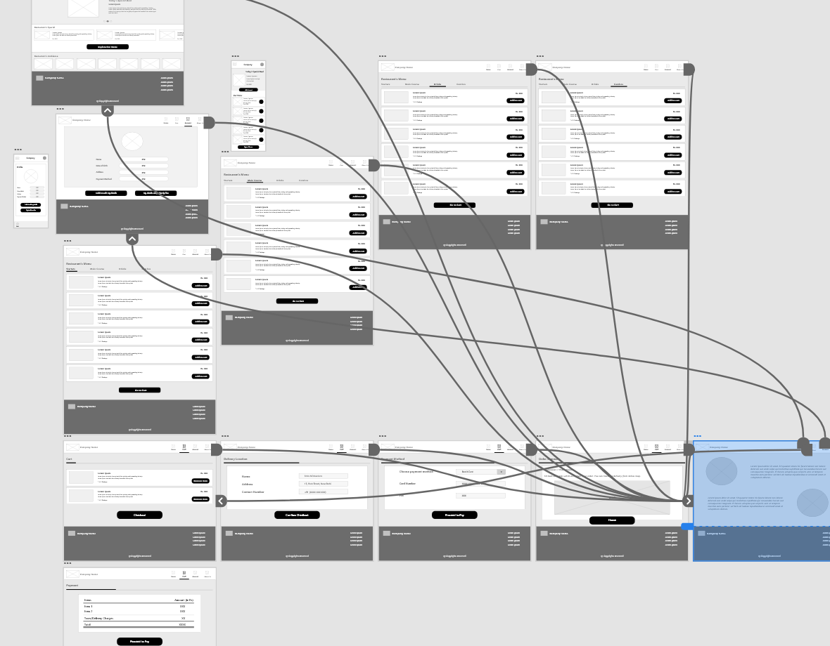
Low-fidelity prototype
Using the completed set of digital wireframes, I created a low-fidelity prototype. The primary user flow I connected was building and ordering a pizza, so the prototype could be used in a usability study.
View the Invitation Restaurant’s App low-fidelity prototype

Slide 15
Usability study: findings
I conducted two rounds of usability studies. Findings from the first study helped guide the designs from wireframes to mockups. The second study used a high-fidelity prototype and revealed what aspects of the mockups needed refining.
Round 1 findings
Round 2 findings
1
Users want to order food quickly
1
The checkout process has too many unnecessary steps
2
Users want a delivery option
2
“Add to Cart” functionality is confusing
3
Users want a pickup option

Slide 16
Refining
the design
Mockups
High-fidelity prototype
Accessibility

Slide 17
Mockups
Early designs allowed for some customization, but after the usability studies, I added additional options to choose food. I also revised the design so users see all the customization options when they first land on the screen.

Slide 18
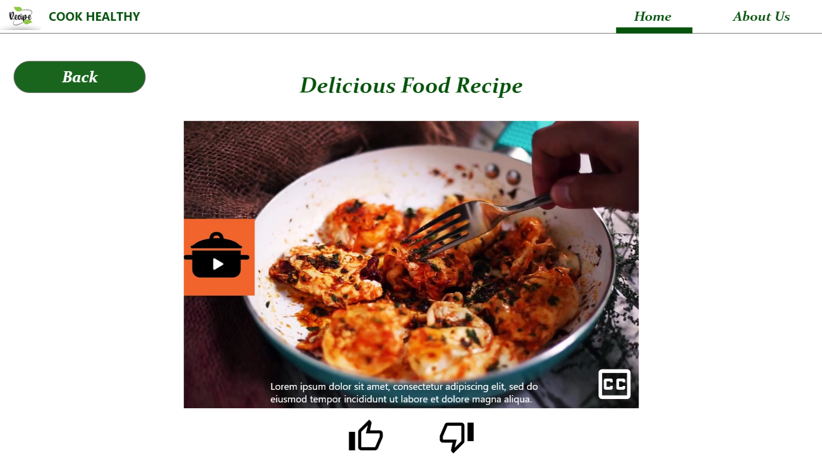
Mockups
The second usability study revealed frustration when people with disability were not able to check the subtitles. Hence we included the closed caption option, and users can now check the subtitles as per their requirement.

Slide 19
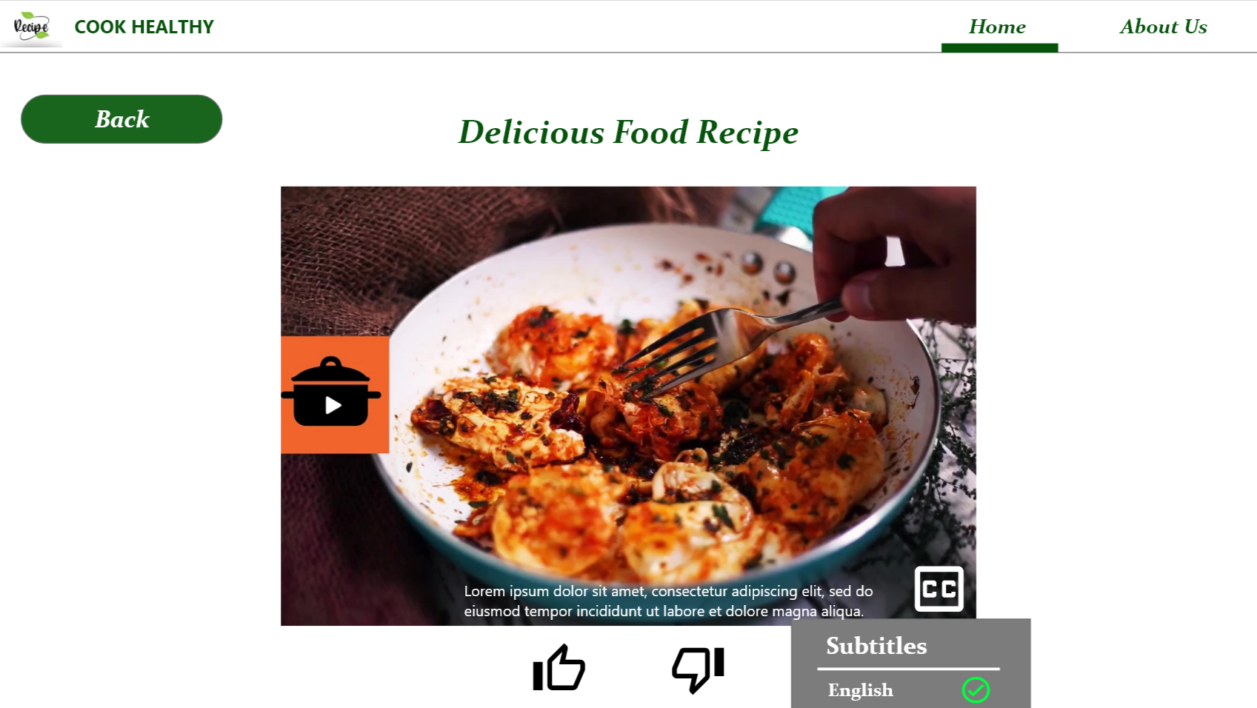
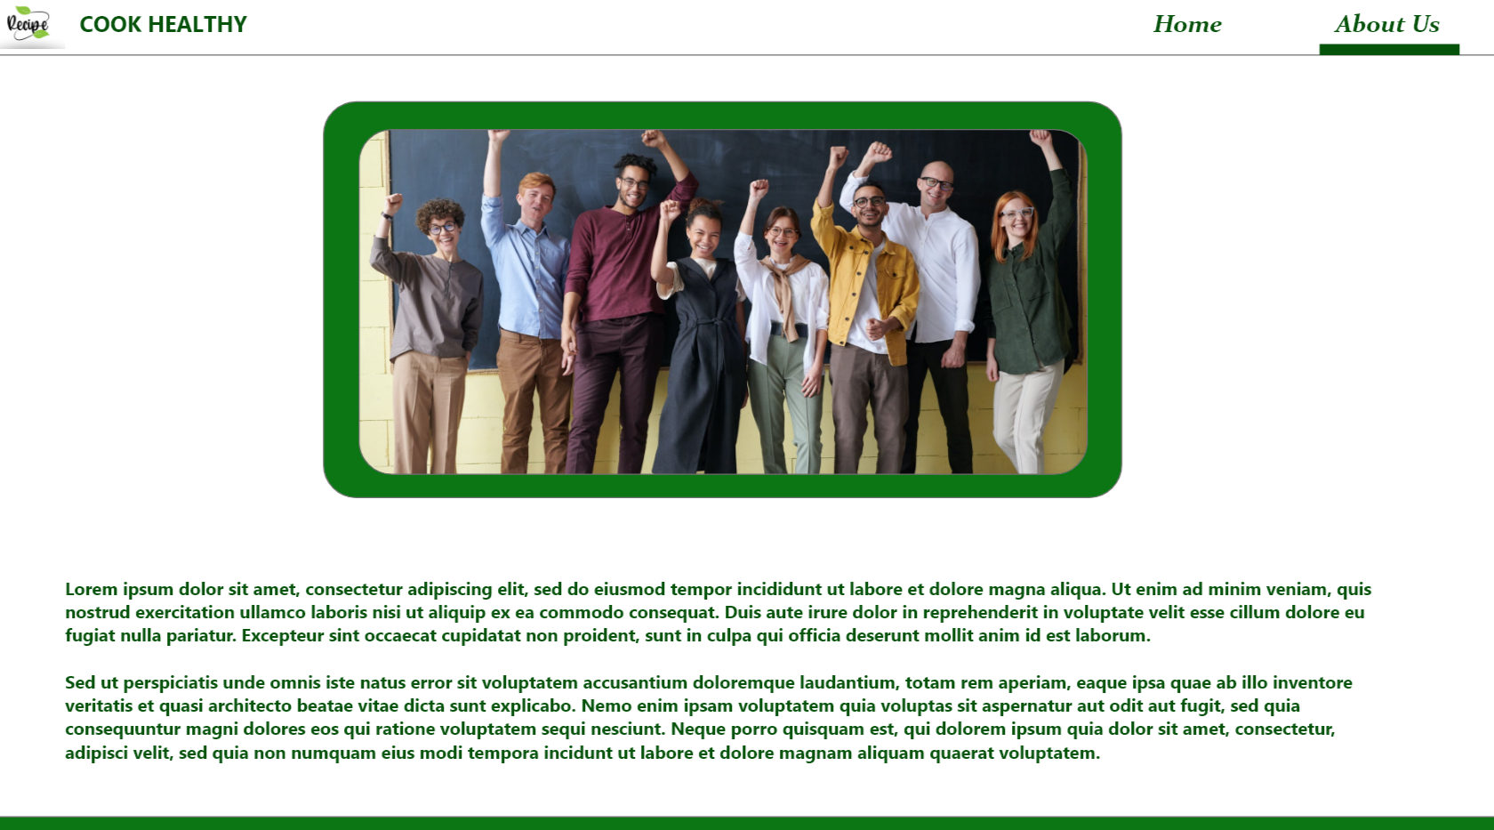
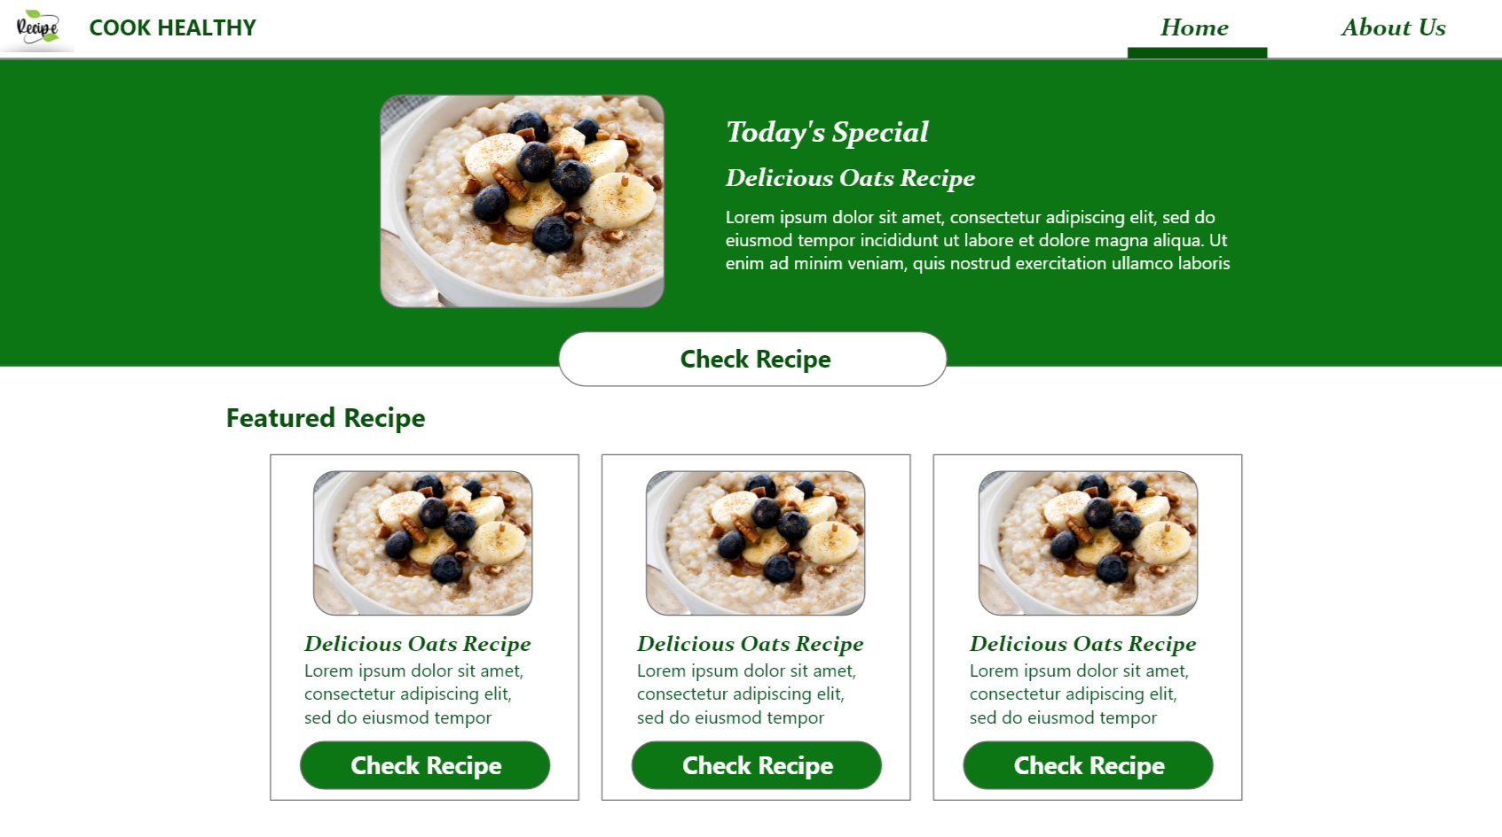
Key mockups

Slide 20
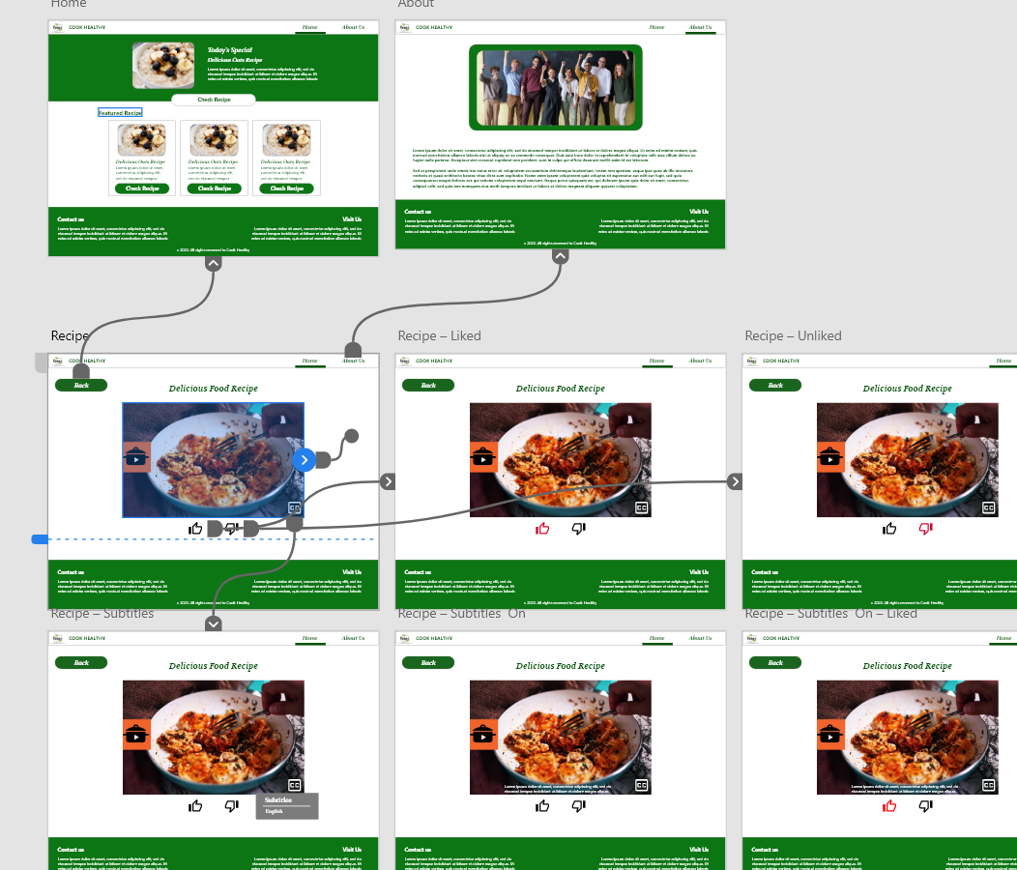
High-fidelity prototype
The final high-fidelity prototype presented cleaner user flows for ordering food and checkout. It also met user needs for a pickup or delivery option as well as more customization.
View the Invitation Restaurant
high-fidelity prototype

Slide 21
Accessibility considerations
1
2
3
Provided access to users who are vision impaired through adding alt text to images for screen readers.
Used icons to help make navigation easier.
Used detailed imagery for food and toppings to help all users better understand the designs.

Slide 22
Going forward
Takeaways
Next steps

Slide 23
Takeaways
Impact:
The app makes users feel like Invitation Restaurant’s app really thinks about how to meet their needs.
One quote from peer feedback:
“The app made it so easy and fun to build my own food! I would definitely use this app as a go-to for a delicious, fast, and even healthy meal.”
What I learned:
While designing the Invitation Restaurant’s app, I learned that the first ideas for the app are only the beginning of the process. Usability studies and peer feedback influenced each iteration of the app’s designs.

Slide 24
Next steps
1
2
Conduct another round of usability studies to validate whether the pain points users experienced have been effectively addressed.
Conduct more user research to determine any new areas of need.

Slide 25
Let’s connect!
Thank you for your time reviewing my work on the Srish’s Food Corner website! If you’d like to see more or get in touch, my contact information is provided below.
Email: imsrishtisharma@gmail.com

Slide 26
Thank you!

